Slide 1
The History of the Tiergarten4Association e.V.(T4) : 2005 - 2023

Slide 2
T4 Founding Principles
“The primary principle of the Association is to undertake original research on Nazi war crimes on its primary research topics and publish this research in books, websites, exhibitions and through lectures bringing this research into the public domain. The underlying aim is to raise public awareness of Nazi War Crimes and to make sure that areas under researched or not researched at all are brought to the attention of the general public, especially younger generations.”

Slide 3
T4 Aims
Continue original research and make it available to the public,
Collect research materials and archive it,
Educate through lectures, website visualization, journals and books and exhibitions,
Lectures filmed and made available on T4 You Tube channel
Victims of Nazi Mercy Killing program have no single place of remembrance and research – T4 Association.

Slide 4
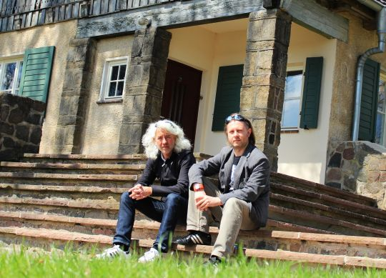
Origins of Tiergarten4Association e.V. (T4)

Slide 5
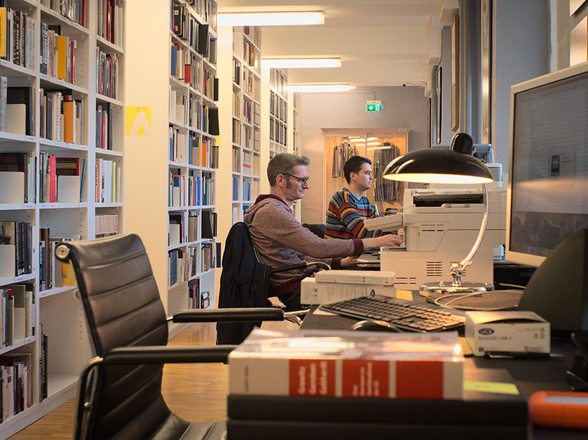
T4 Library and Archive - Wiesenstrasse 16, Berlin 13357 Germany

Slide 6
T4 Library and Archive
18,500 books
More than 3 million pages of digital material primarily war crimes trials
More than 100,000 modern day photographs of sites of Nazi war crimes
Thousands of original photographs from the Nazi period
More than 1,000 films, documentaries and original footage of the Nazi era and Nazi war crimes
450 photo albums of ordinary German people during the Nazi period

Slide 7
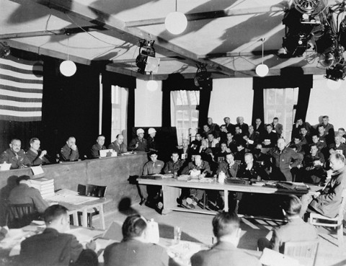
Collecting the Source Material for Research – Post War War Crimes Trials

Slide 8
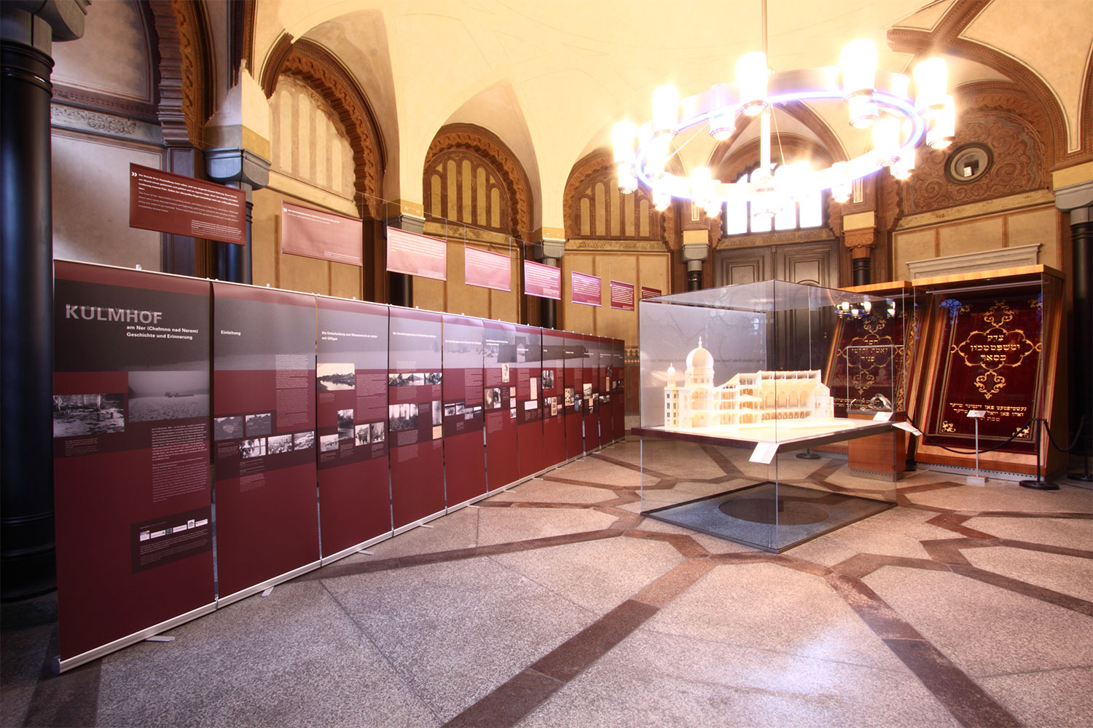
Exhibition on the First Nazi Vernichtungslager – Kulmhof: Centrum Judaicum in Berlin 7 th December 2011

Slide 9
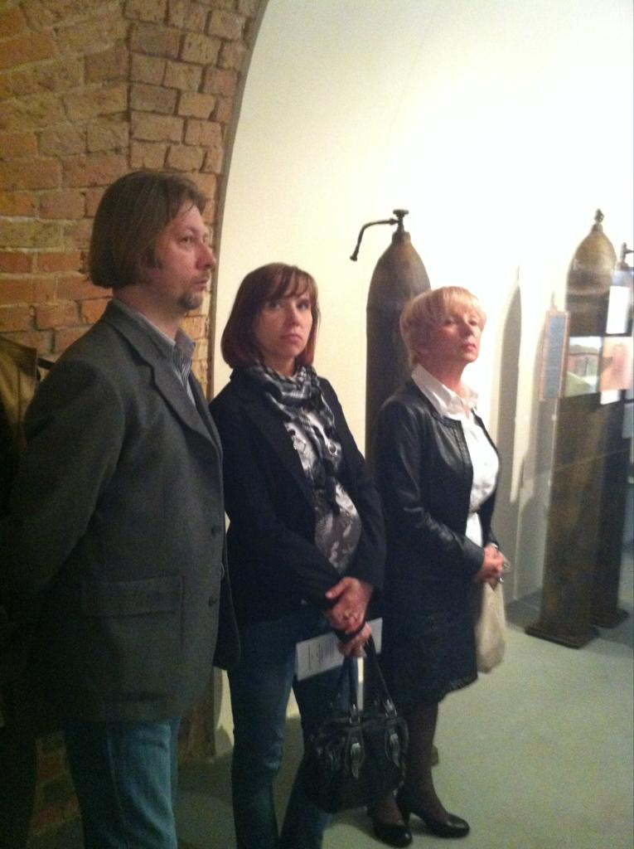
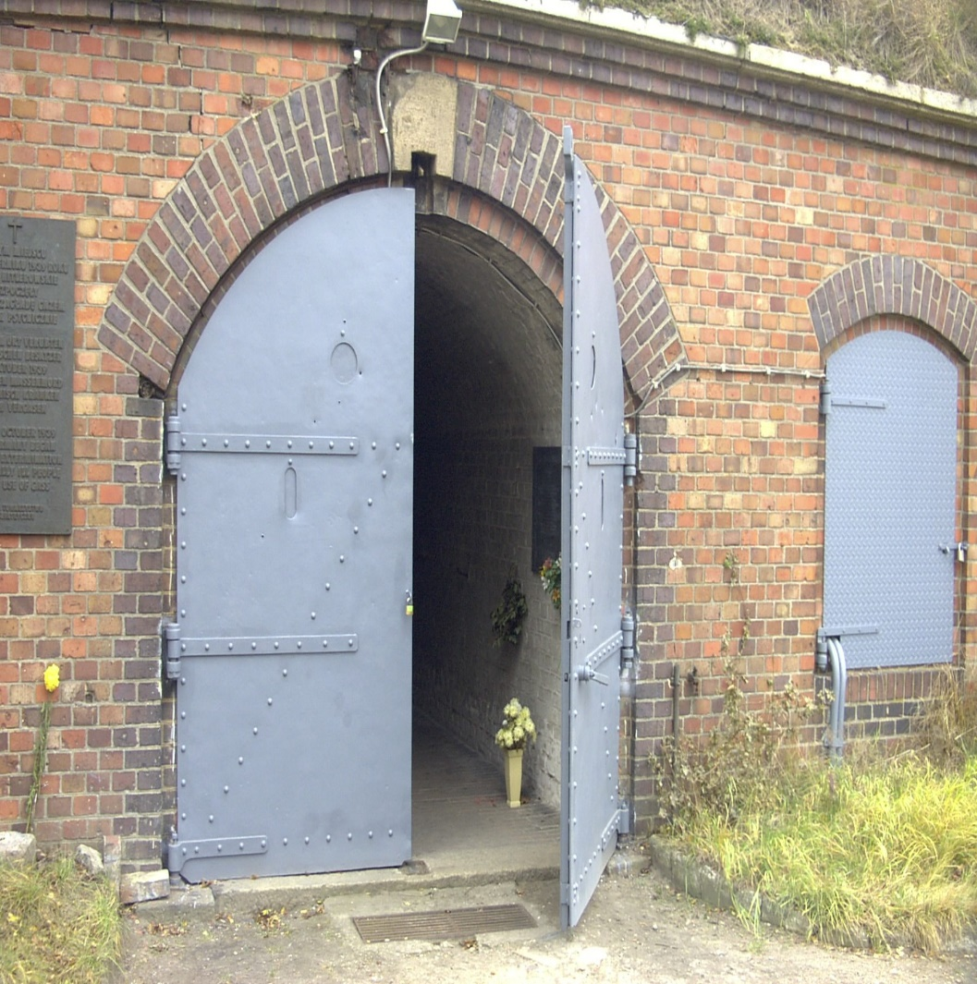
Permanent Exhibition in Fort VII in Poznan to Victims of Nazi Mercy Killing Program: 2013

Slide 10
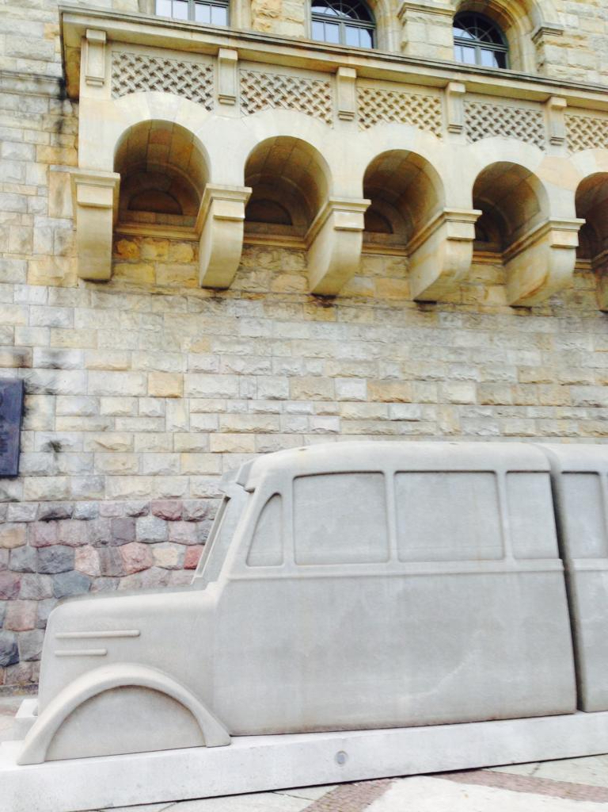
Grey Bus Memorial to Victims of Nazi Mercy Killing in Poznan: 2015

Slide 11
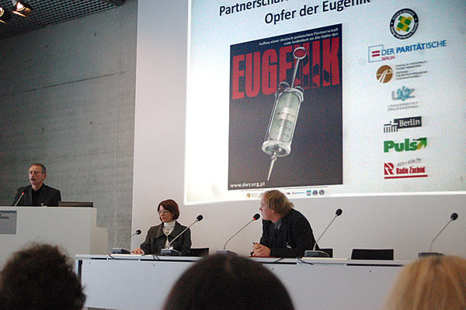
Mercy Killing Memorial - Gedenkort (gedenkort-T4.eu): 2010 to date

Slide 12
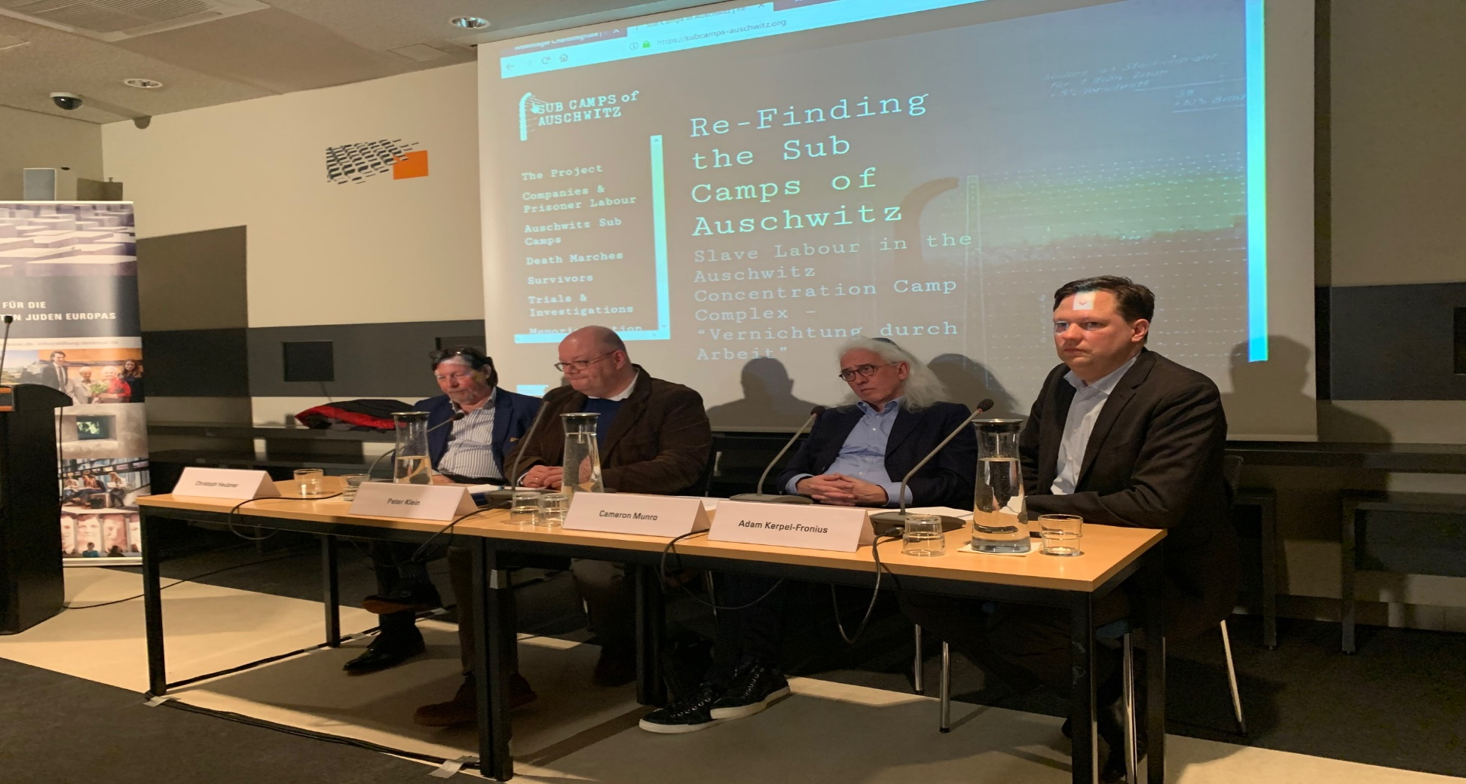
Re-finding the Sub Camps of Auschwitz (subcamps-auschwitz.org): 2005-2020

Slide 13
Books and Journals

Slide 14
Lecture on Nazi Mercy Killing Program in Poland: 2013

Slide 15
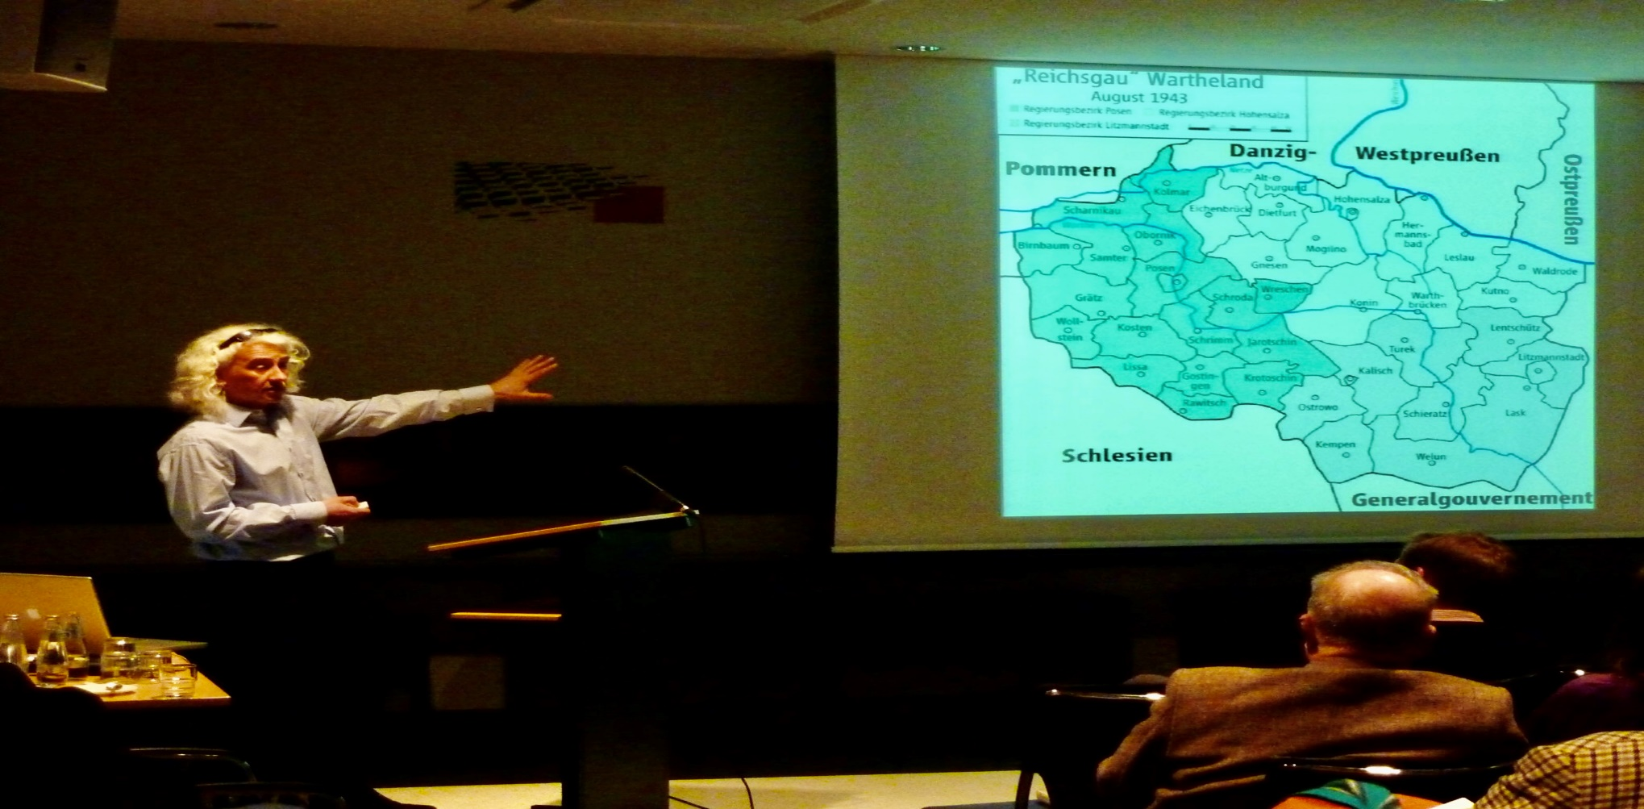
Lecture at Stiftung Denkmal für die ermordeten Juden Europas on Kulmhof Vernichtungslager: 2013

Slide 16
Lecture at Stiftung Denkmal für die ermordeten Juden Europas Komplex Auschwitz – Die vergessenen Außenlager: 2018

Slide 17
3 Lecture Series on the Nazi Use of Poison Gas at the Stiftung Denkmal für die ermordeten Juden Europas: 2022-2023

Slide 18
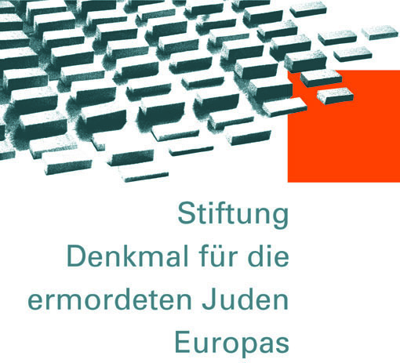
T4 Main Partners

Slide 19
T4 Projects in Development
Ordinary Germans photo album website project for schools
Gas Van exhibition and book
Auschwitz sub camp book
Translation into German and Polish of Auschwitz sub camp website
Book on reconciliation of Jews murdered in Kulmhof by ghetto
Website of 100,000 modern photographs of sites of Nazi war crimes

Slide 20
T4 Future
Association is a ”big present for Berlin and Germany”,
Many people think there is nothing more to be researched on Nazi Germany and its crimes,
Continue unique and original research and bring it into the public domain,
Make Wiesenstrasse a living place for students,
Centre of excellence,
More education and projects directly with schools and students.

